Slide 1

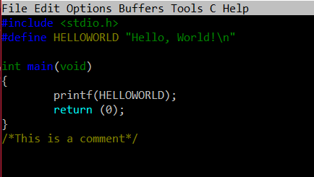
C PROGRAMMING

Slide 2

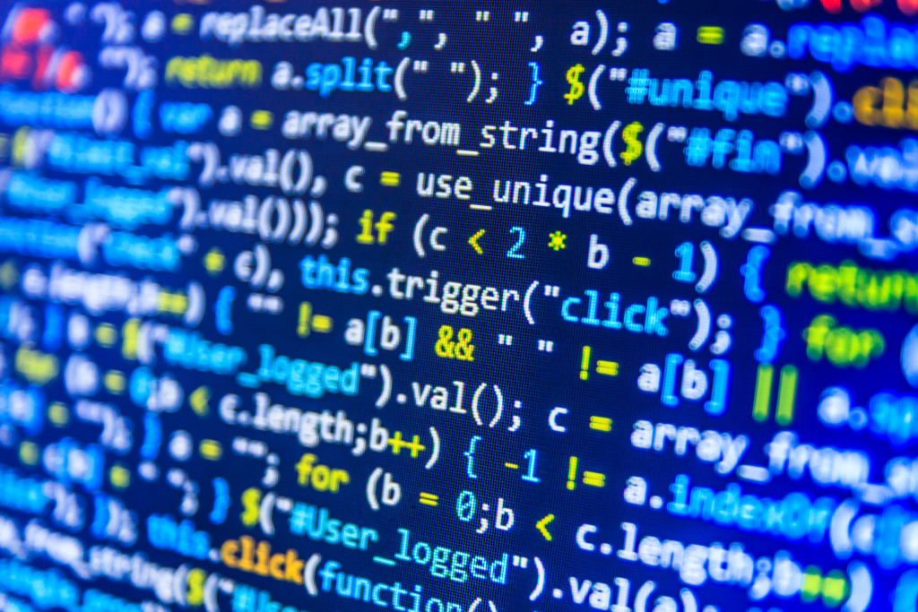
Introduction To
C Programming

Slide 3

C is a General–Purpose , Mid–Level Programming Language That Was Originally Developed By Dennis M. Ritchie To Develop The UNIX Operating System At Bell Labs.
C is Firstly Implemented In 1972.
C is A Successor Of B Language Which Was Introduced Around 1970.
The Language Was Formalized In 1988 By The American National Standard Institute(ANSI)
Language Compilers
Operating systems
Assemblers
Databases
Network Drivers
Print spoolers
Language Interpreters
Utilities
USES OF C
Modern programs
Text editors

Slide 4
Features
Portability
Memory Management
Libraries with rich Functions
Fast and Efficient

